Slide 1

Need for programming; Human Languages and computer programming languages
Applied Thermodynamics | Introduction to Computer programs
Course: Applied Thermodynamics | Chapter: Introduction to Computer programs | Program: Bachelor of Engineering
DISCOVER · LEARN · EMPOWER
Notes:
Welcome to our session on the fundamentals of programming within Applied Thermodynamics. Today we bridge the gap between human thought and machine execution. We will explore why programming is essential for solving complex thermodynamic problems. Remember, our motto at Chandigarh University is to Discover, Learn, and Empower through technology.

Slide 2
Course Outcomes
SLIDE 2 / 10
Course Outcome
CO | BT LEVEL | DESCRIPTION
CO1 | BT2 | Understand the syntax, control structures, and basic constructs of Python programming language.
CO2 | BT3 | Apply functions, modules, and exception handling for modular program development.
CO3 | BT3 | Implement data structures including lists, tuples, dictionaries, and sets for efficient data processing.
CO4 | BT4 | Analyze and manipulate files, strings, and perform data handling operations.
CO5 | BT6 | Design and develop real-world applications integrating multiple Python concepts.
Chandigarh University
2 / 10
Notes:
This lecture directly supports our Course Outcomes CO2 and CO3. By understanding programming languages, you learn to apply functions and modules for modular development. You will also learn to implement data structures like lists and dictionaries for efficient data processing in thermodynamic calculations.

Slide 3
Learning Objectives
SLIDE 3 / 10
Learning Outcomes
1
Analyze the need for programming in solving engineering thermodynamic problems.
2
Differentiate between human languages and computer programming languages.
3
Classify programming languages based on their level of abstraction.
4
Evaluate the role of compilers and interpreters in code execution.
5
Apply basic syntax rules to write simple thermodynamic calculation scripts.
Chandigarh University
3 / 10
Notes:
By the end of this session, you will be able to analyze why we need programming for thermodynamics. You will differentiate between how humans speak and how computers understand instructions. We will classify languages and evaluate how compilers translate our code into machine actions.

Slide 4
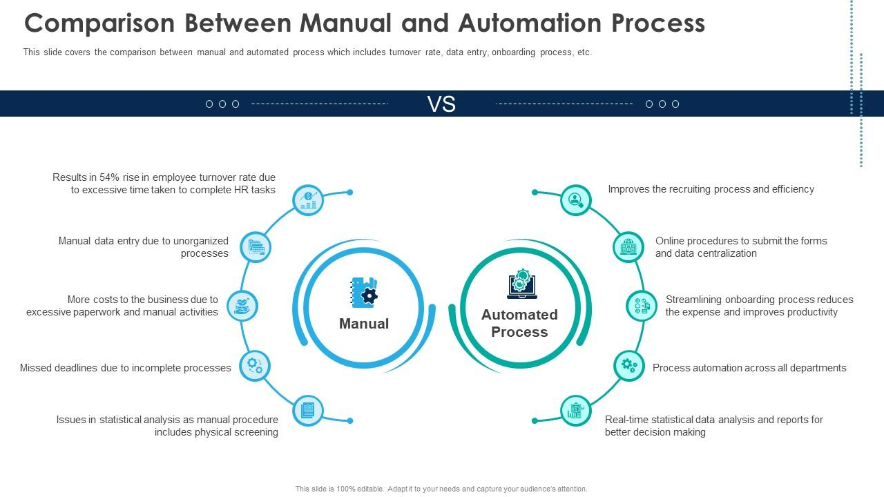
Lecture
SLIDE 4 / 10
Need for Programming in Engineering
1
Programming automates repetitive calculations required in thermodynamic cycle analysis.
2
It enables complex simulations that are impossible to solve manually.
3
Software tools allow rapid iteration of design parameters for optimization.
4
Programming reduces human error in handling large datasets and equations.
5
It bridges the gap between theoretical formulas and practical engineering solutions.
Automation Of HR Workflow Comparison Between Manual And Automation Process | Presentation Graphics | PowerPoint PPT Presentation Example |
Chandigarh University
4 / 10
Notes:
Consider a Rankine cycle analysis where you must calculate efficiency for ten different pressure ratios. Doing this manually takes hours and invites calculation errors. Programming automates this, allowing you to iterate through parameters instantly. This automation is the primary need for programming in our field.

Slide 5
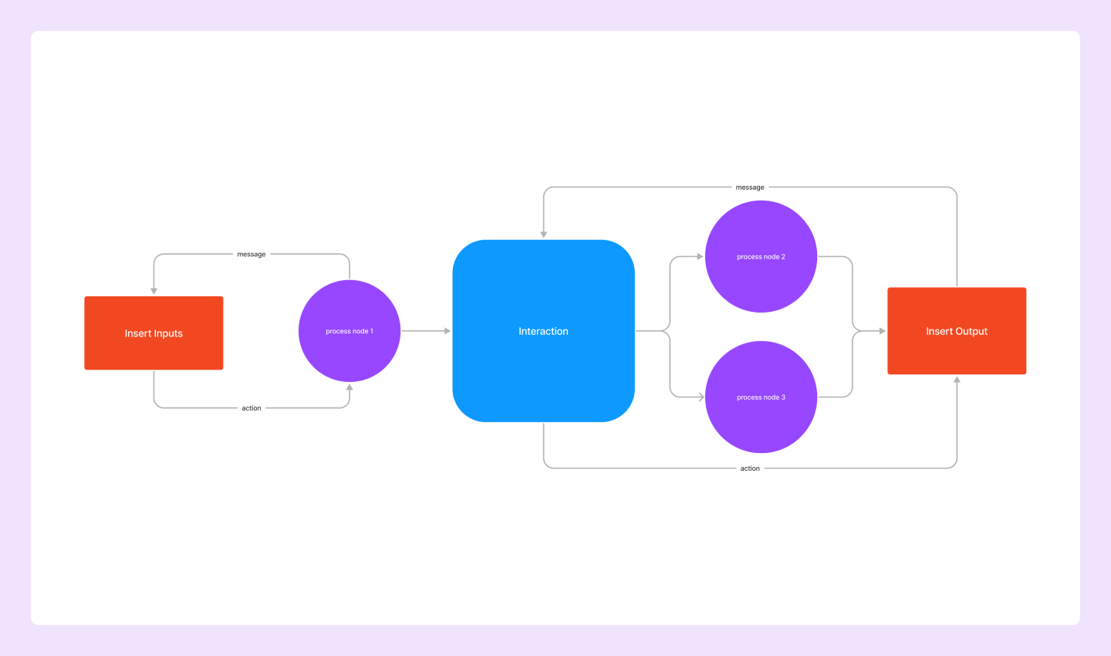
Lecture
SLIDE 5 / 10
Human Languages vs. Computer Languages
1
Human languages are ambiguous, flexible, and context-dependent for communication.
2
Computer languages are precise, rigid, and require strict syntax rules.
3
Humans use natural words like 'heat' or 'work' with implied meanings.
4
Computers require specific keywords like 'if', 'while', and 'print' to act.
5
Misunderstanding in human language is common, but in code it causes failure.
Source: cdn.sanity.io
Chandigarh University
5 / 10
Notes:
In human language, if I say 'the engine is hot', you understand the context. In programming, if you write 'engine is hot' without defining variables, the computer fails. Human languages allow ambiguity, but computer languages demand absolute precision to execute instructions correctly.

Slide 6
Lecture
SLIDE 6 / 10
Classification of Programming Languages
1
Low-level languages like Assembly are close to machine hardware instructions.
2
High-level languages like Python are closer to human logical thinking.
3
Machine language consists of binary code (0s and 1s) understood directly.
4
Assembly language uses mnemonics to represent machine instructions simply.
5
Modern engineering uses high-level languages for efficiency and readability.
Chandigarh University
6 / 10
Notes:
We classify languages by their level of abstraction. Machine language is the raw binary that the CPU executes. Assembly uses mnemonics like 'ADD' or 'MOV' to represent these binary codes. However, we primarily use high-level languages like Python today because they are easier to write and maintain.

Slide 7
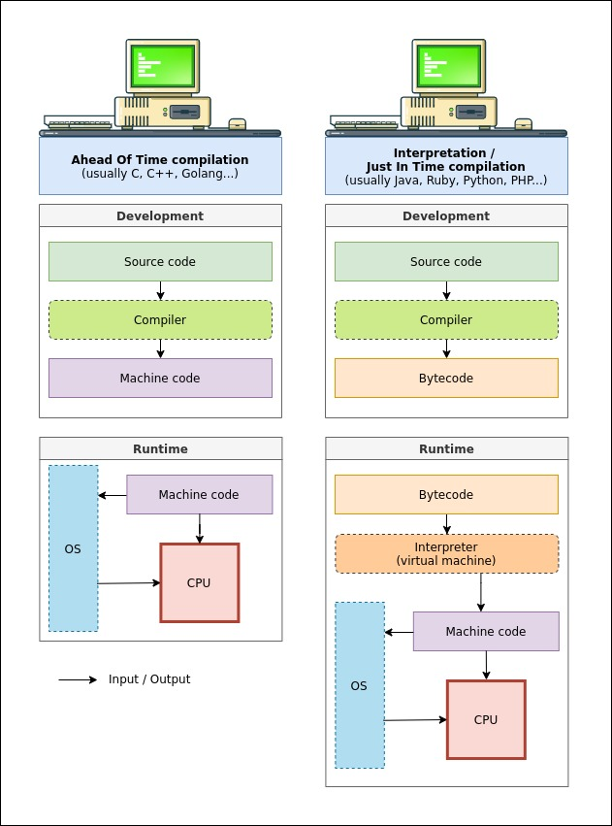
Translation
SLIDE 7 / 10
Compilers and Interpreters
1
Compilers translate the entire source code into machine code before execution.
2
Interpreters translate and execute the code line-by-line during runtime.
3
Compiled programs generally run faster but take longer to develop initially.
4
Interpreted programs are easier to debug but may run slower.
5
Python uses an interpreter, while C++ typically uses a compiler.
Source: thevaluable.dev
Chandigarh University
7 / 10
Notes:
How does our code reach the computer? Compilers translate the whole program into an executable file first, like translating a book before reading. Interpreters translate line-by-line as you run the program, like a live translator. For thermodynamic simulations, compiled languages offer speed, while interpreted languages offer flexibility.

Slide 8
Lecture
SLIDE 8 / 10
Syntax and Semantics in Programming
1
Syntax refers to the grammatical rules and structure of the code.
2
Semantics refers to the meaning and logic behind the code statements.
3
A syntax error occurs when the code violates language grammar rules.
4
A semantic error occurs when the code runs but produces wrong results.
5
Both errors must be identified and corrected for successful program execution.
Chandigarh University
8 / 10
Notes:
Think of syntax as the grammar of a sentence. If you write 'The cat sleeps on the mat', it is grammatically correct. If you write 'The mat sleeps on the cat', the syntax is fine, but the meaning is wrong. In programming, a syntax error stops the program, while a semantic error gives wrong thermodynamic data.

Slide 9

Lecture
SLIDE 9 / 10
Key Takeaways
1
Programming is essential for automating complex thermodynamic calculations and simulations.
2
Computer languages require strict syntax unlike the ambiguity of human languages.
3
High-level languages are preferred for engineering due to their readability.
4
Compilers and interpreters are the tools that translate human code to machine.
5
Understanding syntax and semantics is critical for debugging engineering programs.
Source: blog.infodiagram.com
Chandigarh University
9 / 10
Notes:
To summarize, programming automates our work and reduces errors in thermodynamics. We must respect the strict rules of computer languages compared to human speech. Remember that compilers and interpreters are the bridges between our logic and the machine. Finally, always check both syntax and semantics to ensure your code works correctly.

Slide 10
Lecture
SLIDE 10 / 10
References
STEAM TURBINE
Theory and Practice — W.A.J. Kearton
• A Textbook of Thermal Engineering — P.K. Nag
• Heat Engineering — Dr. Vasandani and Dr. D.S. Kumar
Chandigarh University
10 / 10
Notes:
For further reading on the theoretical applications of these concepts, please refer to the standard texts listed here. Dr. P.K. Nag provides excellent coverage of thermal engineering principles. The works by Dr. Vasandani and Dr. D.S. Kumar offer deep insights into heat engineering applications.

